Slide 1


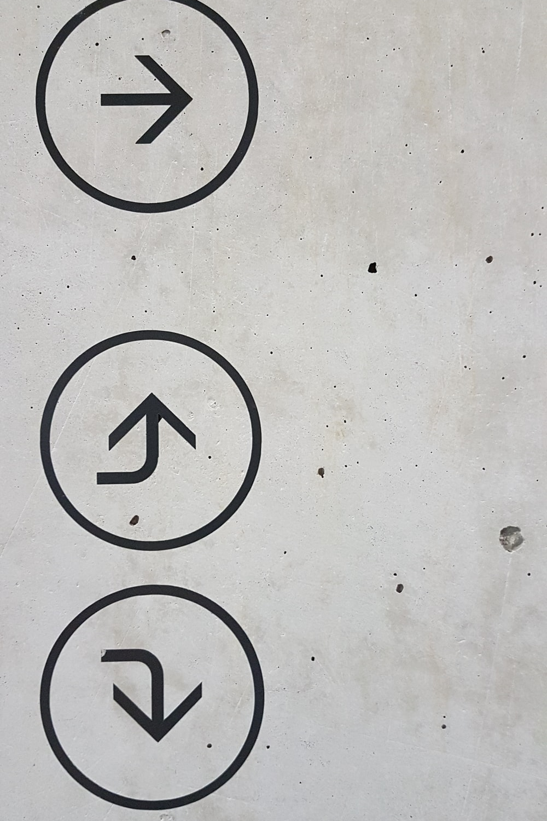
Predicting Next Day Closing Stock Price Direction using Machine Learning Methods.
By Achraf Safsafi
Bellevue University
DSC 630
Dr. Brett Werner

Slide 2
Problem Statement
The goal of the project is to predict an increase or decrease in Apple stock price for the next day using different machine learning techniques. Then a comparison of models' performance will be performed. The results will help daily traders to take an accurate decision. If tomorrow's closing price is higher than today's closing price, the stock could be bought, else could be sold.

Slide 3
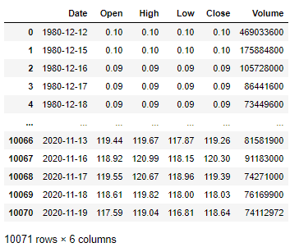
Data Set:
Data are extracted from yahoo finance. Data are collected from 1980 to the present.

Slide 4
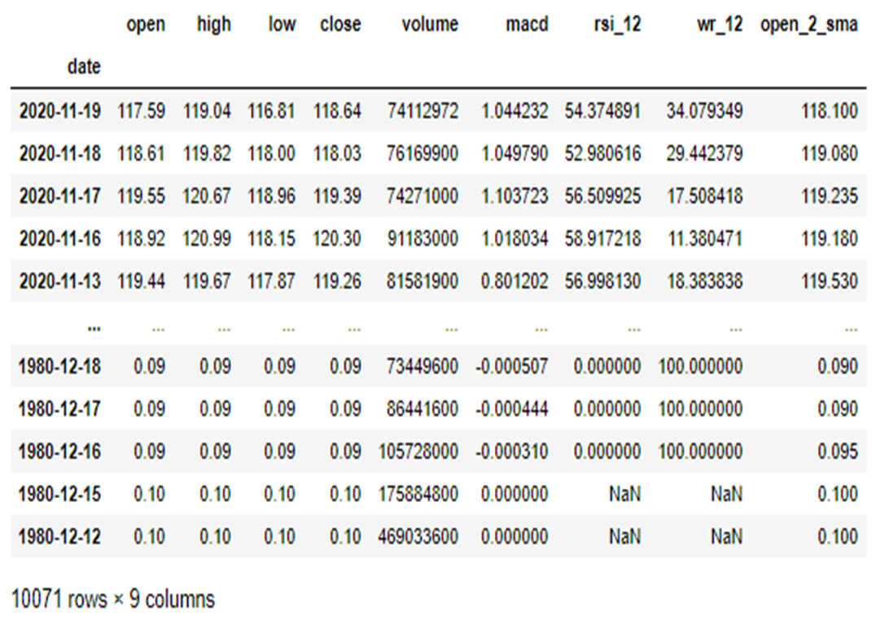
In this project, open, high, low, and close price are used as predictors. In addition, Moving Average Convergence Divergence (MACD), Williams %R (WR), Relative Strength Index (RSI), and 2 days simple moving average on open price (open_2_sma) are selected as additional predictors
Defining The Independent Variables

Slide 5
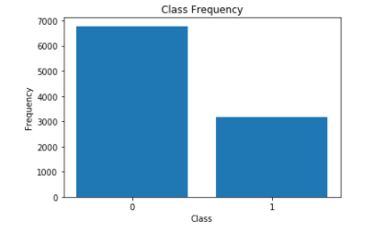
The target variable is taking two values '0' or '1'. The values will be classified as class '1' if the closing price of the next day is higher than the closing price of the actual day, else, the values will be classified as class '0'.
Defining The Dependent Variable
Slight Imbalance Data

Slide 6

Data is clean and ready for use

Slide 7
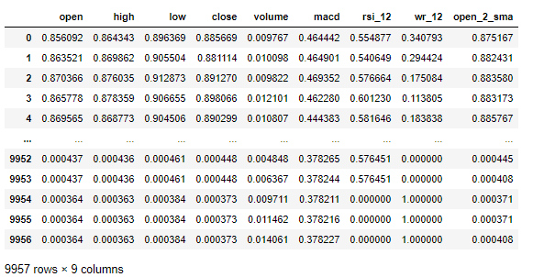
Feature scaling

Slide 8
Splitting data into training and testing. Train:67%, Test :33%

Slide 9
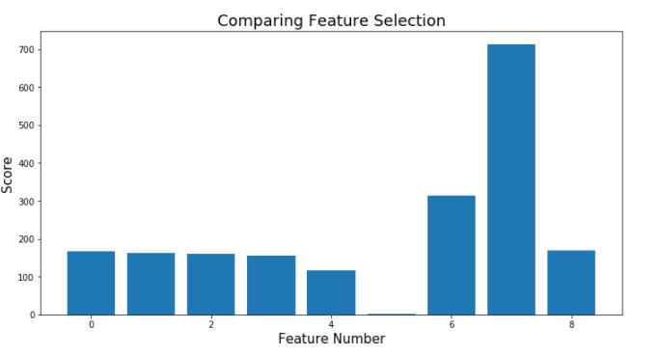
Feature Selection using ANOVA F-value Method
Feature 0 (open) : 166.610988
Feature 1 (high) : 162.526005
Feature 2 (low) : 161.085385
Feature 3 (close) : 156.165251
Feature 4 (volume) : 115.551111
Feature 5 (macd) : 1.235863
Feature 6 (rsi_12) : 314.550010
Feature 7 (wr_12) : 712.764245
Feature 8 (open_2_sma) : 169.214890
macd feature (5) will be dropped
as it is unimportant

Slide 10

Algorithms
Logistic Regression
Gaussian Naive Bayes
Support Vector Classifier (SVC) using RBF Kernel
Decision Tree
Random Forest
XGBoost

Slide 11
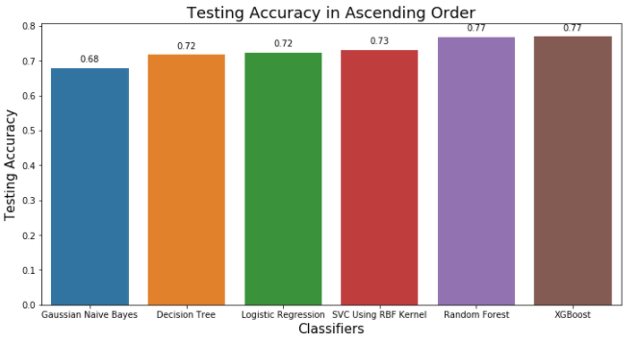

Slide 12
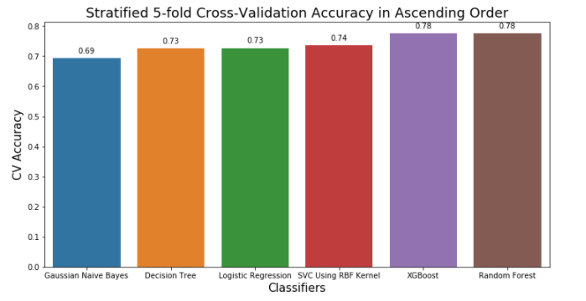

Slide 13
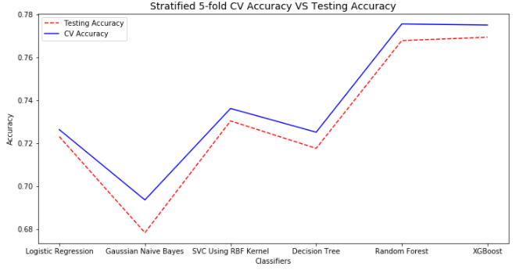

Slide 14
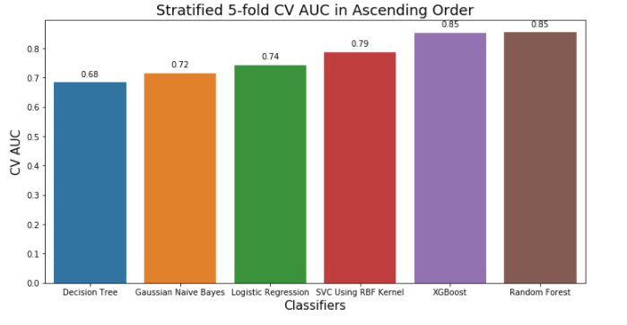

Slide 15


Conclusion
The evaluation results show that The Random Forest, and XGBoost algorithms are the winners.
They are more fitting for predicting the next day closing stock price trend.
Thank you

